Slide 1
Interaction in Stokes regime
Particle‒wall interaction
Q1: |F ^{I}| = |F ^{II}| a) > b) = c) <
Case I
V
Intuitively, one can say |F ^{I}| > |F ^{II}| since in Case I the particle is moving towards the wall. This, indeed, holds true if we take inertia of the fluid into account. However, the Stokes regime implies that inertial effects are neglected. See a more detailed explanation in Section 4 (Discussion) of: “Brenner, H. The slow motion of a sphere through a viscous fluid towards a plane surface. Chem. Eng. Sci., 16(3-4), 242-251 (1961)”
F ^{I}
Case II
V
F ^{II}
The distance to the wall is the same in both cases

Slide 2
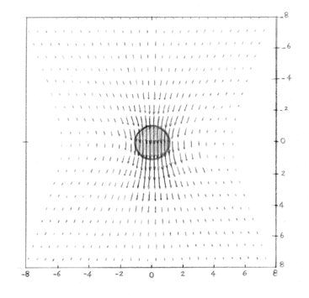
Interaction in Stokes regime
Particle‒wall interaction
Q2: F a) upwards ↑
b) downwards ↓
Q3: T a) CW ↻
b) CCW ↺
A particle translating along an infinite rigid plane
V
Disturbance generated by a particle moving in a viscous fluid
Disturbance of V at the wall
The Stokes disturbance field induced by a single particle translating in a viscous flow is shown in the figure above. The disturbance has a net force acting on the wall as if it wants to push it upwards. Since the wall is stationary, it has an equal opposite reaction whose reflection at the location of the particle generates a downwards force and a clockwise torque. Note that the wall reaction ↓ is added to the viscous drag ↓ acting on the particle (−6πμaV) which exists even if there is no wall.
T
Wall reaction
F
Wall reaction effect on the particle

Slide 3
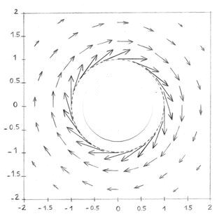
Interaction in Stokes regime
Particle‒wall interaction
Q4: F a) upwards ↑
b) downwards ↓
Q5: T a) CW ↻
b) CCW ↺
A particle rotating along an infinite rigid plane
Ω
Disturbance of Ω at the wall
T
Wall reaction
F
Note that the wall reaction ↺ is added to the viscous drag ↺ acting on the particle (−8πμa³Ω) which exists even if there is no wall.
Disturbance generated by a particle rotating in a viscous fluid

Slide 4
Interaction in Stokes regime
Particle‒particle interaction
Q6: |F₁| = |F₂| a) > b) = c) <
A pair of particles following each other along their line of centers
Intuitively, one can say |F₁| < |F₂| since the 1st particle is in the wake of the 2nd one. This, indeed, holds true if we take inertia of the fluid into account. However, the Stokes regime implies that inertial effects are neglected. Therefore, the viscous forces and reflections/reactions F_{αα} (discussed in the first slide: reaction of pushing the non-moving 2nd by 1st = reaction of pulling the non-moving 1st by the 2nd) as well as the disturbances F_{αβ} (pulling 1st by 2nd = pushing 2nd by 1st) are equal. See more details in: “Stimson, M., & Jeffery, G. B. The motion of two spheres in a viscous fluid. Proc. R. Soc. Lond. Ser. A, 111(757), 110-116 (1926)”
1
2
Pull by 2nd
V
Push by 1st
V
F₁₂ = F₂₁
F₁₁ = F₂₂
Reactions
a₁ = a₂
Hint: F₁ = F₁₁ + F₁₂ & F₂ = F₂₂ + F₂₁
F_{αα}: The viscous drag acting on particle α due to its translation at V_{α} next to the non-moving spherical particle β (= 3 ‒ α)
F_{αβ}: The disturbance due the translation of particle β at V_{β} felt by particle α (= 3 ‒ β)

Slide 5
Interaction in Stokes regime
Particle‒particle interaction along their line of centers
λ = a₂ / a₁
ξ = 2h / (a₁ + a₂)
h = gap
λ = 1
λ = 0.5

Slide 6
Interaction in Stokes regime
Particle‒particle interaction
For these questions the values of resistances, given in Table 1 of O'Neill‒Majumdar (1970) ZAMP paper, are needed for the cases where the interaction forces/torques are in opposite directions.
Case I
V
V
Q7: F₁^{I} | a) upwards ↑
 | b) downwards ↓
Q8: T₁^{I} | a) CW ↻
 | b) CCW ↺
A pair of particles translating normal to their line of centers
T₁₂ from V₂
F₁₂ from V₂
Disturbance of V₁
Reaction
T₁₁
T₁
F₁
Q11: |F₁^{I}| < |F₁^{II}| a) > b) = c) <
Q12: |T₁^{I}| < |T₁^{II}| a) > b) = c) <
F₁₁ (reflection of V₁ reaction
+ viscous force from V₁) > F₁₂
Case II
V
Q9: F₁^{II} | a) upwards ↑
 | b) downwards ↓
Q10: T₁^{II} | a) CW ↻
 | b) CCW ↺
T₁
T₁₂
F₁₂
T₁₁
F₁
F₁₁
The distance is the same in both cases
V
Note: due to symmetry F_{i} & T_{i} are equal for particles
Hint: F₁ = F₁₁ + F₁₂ & T₁ = T₁₁ + T₁₂

Slide 7
Interaction in Stokes regime
Particle‒particle interaction normal to their line of centers: translation

Slide 8
Interaction in Stokes regime
Particle‒particle interaction
For these questions the values of resistances, given in Table 1 of O'Neill‒Majumdar (1970) ZAMP paper, are needed for the cases where the interaction forces/torques are in opposite directions.
Case I
Q13: F₁^{I} | a) upwards ↑
 | b) downwards ↓
Q14: T₁^{I} | a) CW ↻
 | b) CCW ↺
A pair of particles rotating normal to their line of centers
Ω
Ω
T₁₂
T₁
F₁
F₁₂
F₁₁
Q17: |F₁^{I}| > |F₁^{II}| a) > b) = c) <
Q18: |T₁^{I}| > |T₁^{II}| a) > b) = c) <
T₁₁
Case II
Q15: F₁^{II} | a) upwards ↑
 | b) downwards ↓
Q16: T₁^{II} | a) CW ↻
 | b) CCW ↺
Ω
Ω
Exception! depends on λ
T₁₂
T₁
F₁
F₁₂
F₁₁
T₁₁
The distance is the same in both cases
Note: due to symmetry F_{i} & T_{i} are equal for particles
Hint: F₁ = F₁₁ + F₁₂ & T₁ = T₁₁ + T₁₂

Slide 9
Interaction in Stokes regime
Particle‒particle interaction normal to their line of centers: rotation

